Slide 1
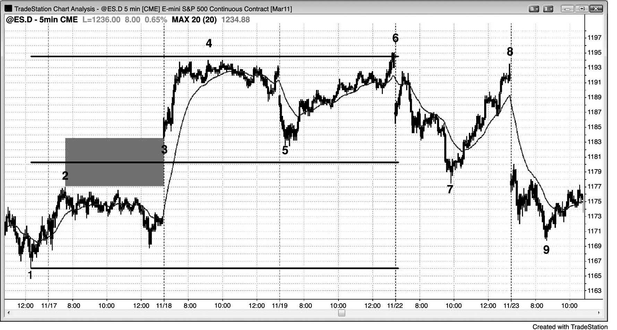
FIGURE 8.1 Measuring Gap

Slide 2
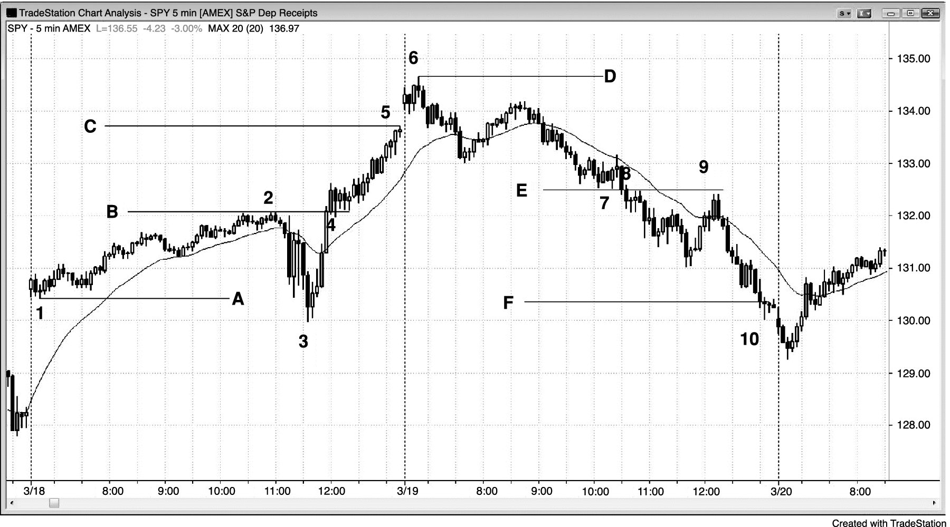
FIGURE 8.2 Measuring Gaps

Slide 3
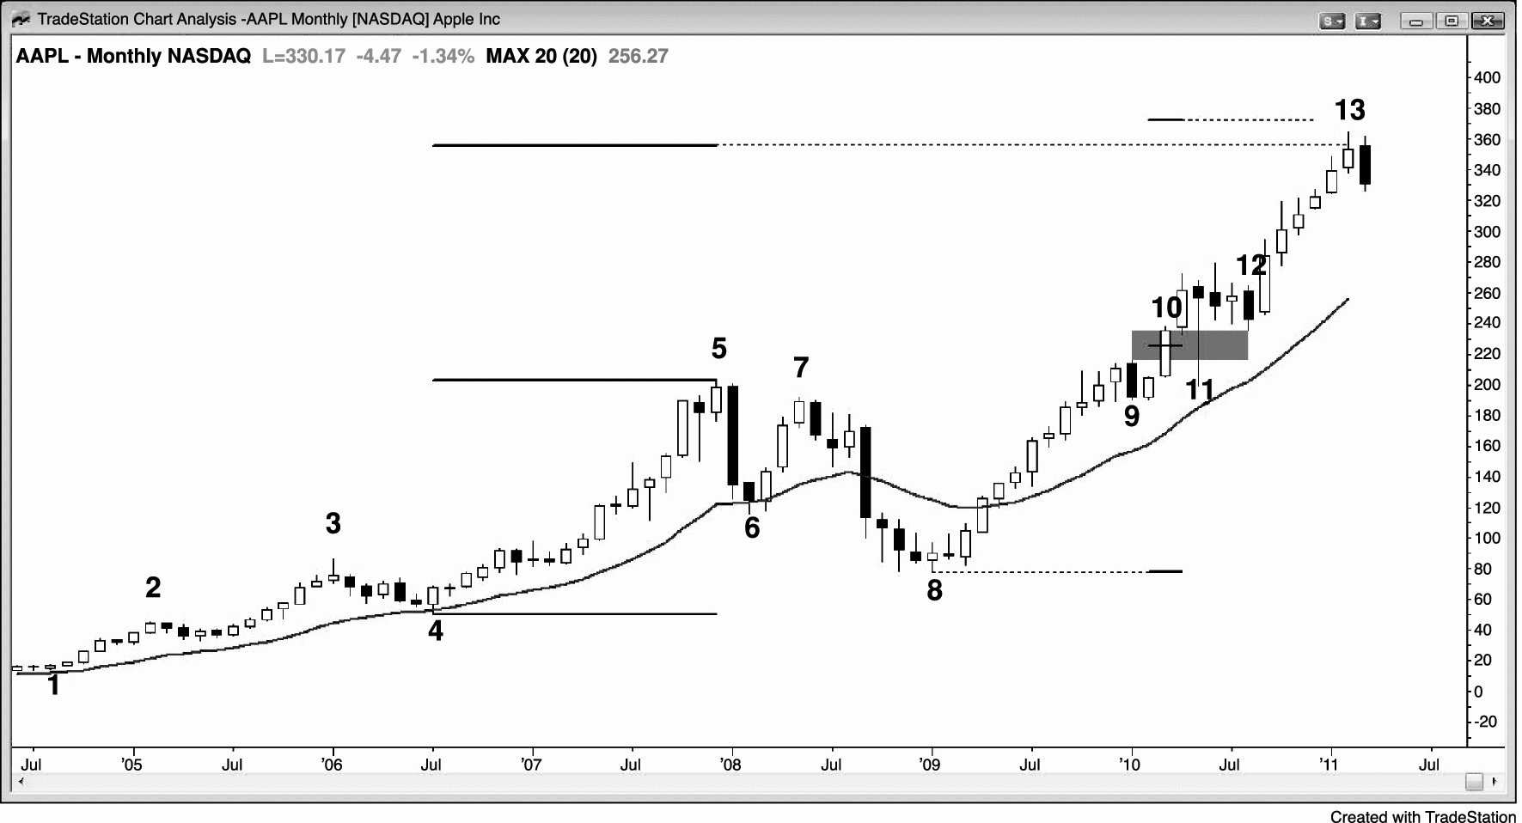
FIGURE 8.3 Profit Taking at Measured Move Targets

Slide 4
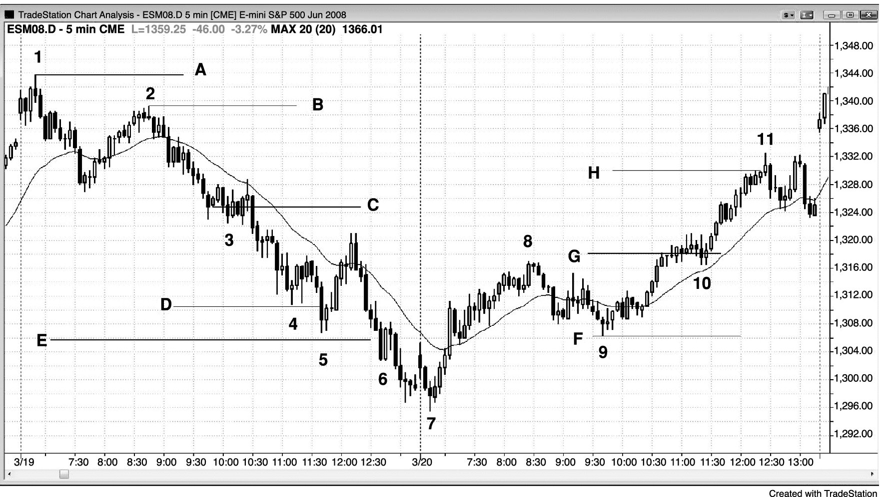
FIGURE 8.4 Measured Moves

Slide 5
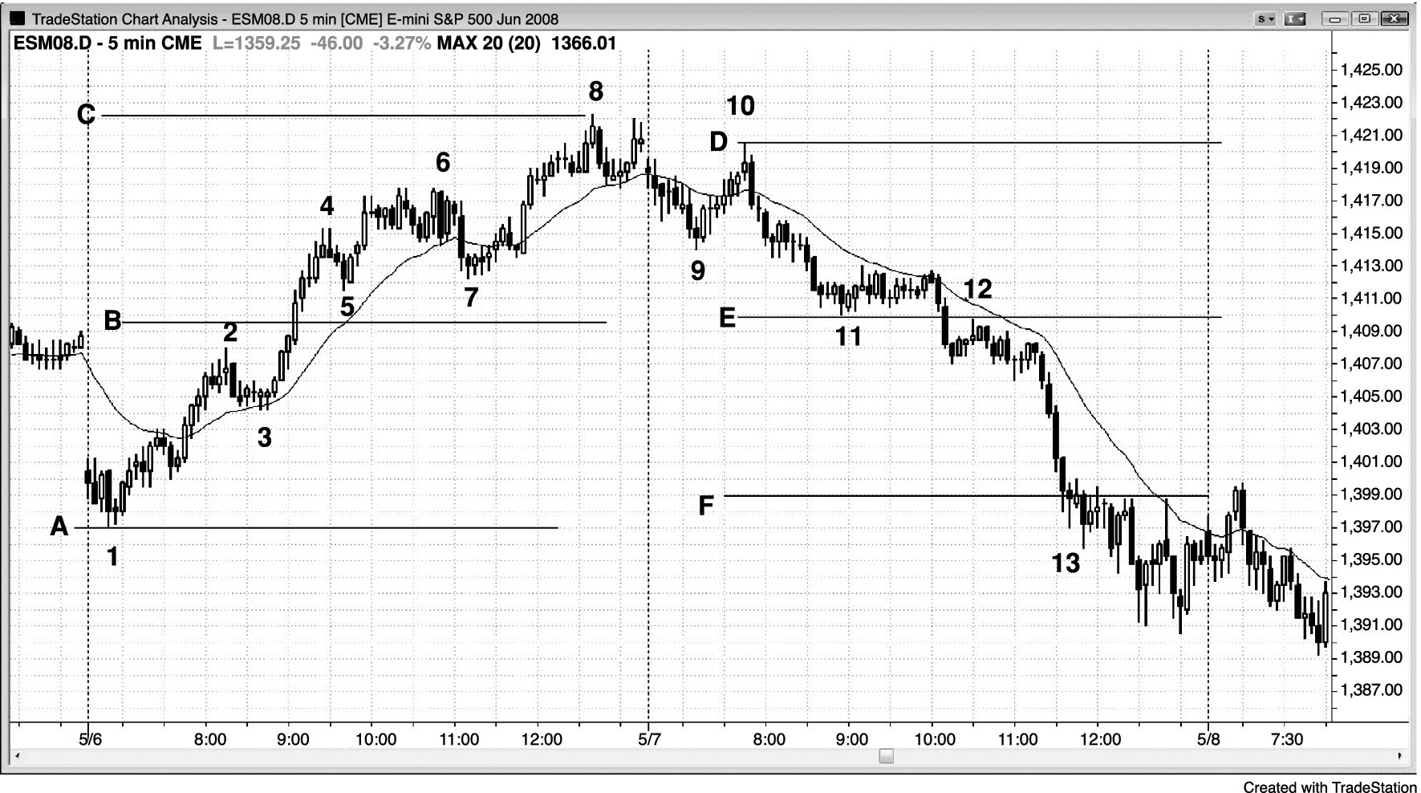
FIGURE 8.5 Measuring Gaps

